Slide 1
Java Streams

Slide 2
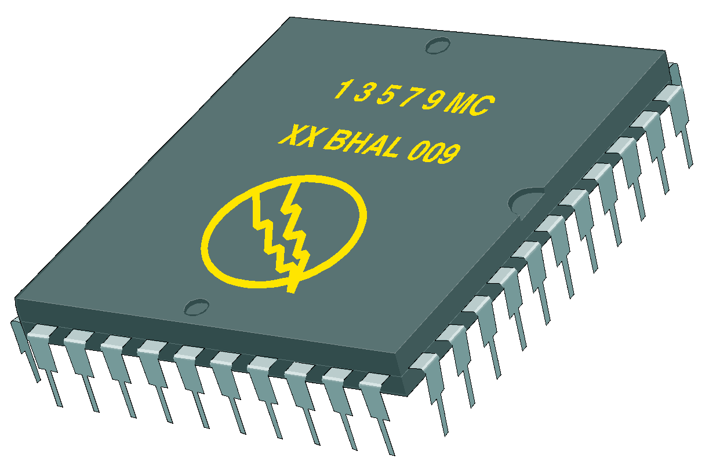
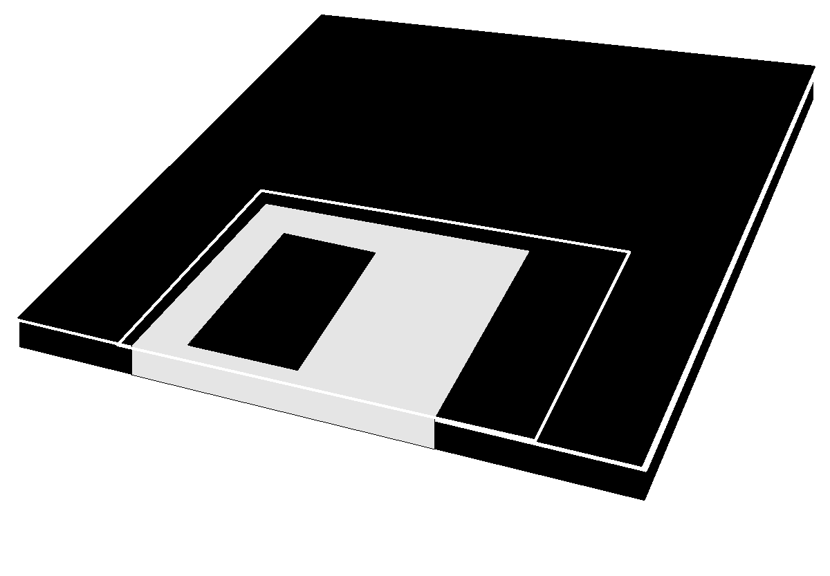
Java Streams
All modern I/O’s are stream based.
A stream is a sequence of units of data coming from or going to an I/O device.
An input stream may be associated with the keyboard or a file.
An an output stream may be associated with the screen or a file.
There are two types of stream, text & binary.
A binary stream is a sequence of bytes.
A text stream is a sequence of characters.
k j i h g f e d c b a
output stream
a b c d e f g h i j k
input stream

Slide 3
Some abstract Java Stream Classes
InputStream - for reading a stream of bytes
OutputStream - for writing a stream of bytes
Reader - for reading a stream of characters
Writer - for writing a stream of characters.

Slide 4
Abstract Class InputStream
All byte stream readers are subclasses of InputStream.
Some of the methods:
int read() throws IOException
int read(byte[] b) throws IOException
int available() throws IOException
void close() throws IOException

Slide 5
Abstract Class OutputStream
All byte stream writers are subclasses of OutputStream.
Some of the methods:
void write(int b) throws IOException
void write(byte[] b) throws IOException
void flush() throws IOException
void close() throws IOException

Slide 6
Abstract Class Reader
All text stream readers are subclasses of Reader.
Some of the methods:
int read()
int read(char[] cbuf)
boolean ready()
void close()

Slide 7
Abstract Class Writer
All text stream writers are subclasses of Writer.
Some of the methods:
void write(int c)
void write(char[] cbuf)
void write(String str)
void flush()
void close()

Slide 8
System.out
System.out is a kind of OutputStream.
It's a PrintStream object
PrintStream is a subclass of OutputStream.
// Type cast System.out into an OutputStream.
OutputStream stdout = System.out;
stdout.write(104); // ASCII 'h'
stdout.flush();

Slide 9
Handle IOExceptions
public static void main(String[] args) {
OutputStream stdout = System.out;
try {
stdout.write(104); // 'h'
stdout.write(105); // 'i'
stdout.write(10); // '\n'
} catch (IOException e) {
e.printStackTrace();
}
}

Slide 10
Another way
public static void main(String[] args) throws IOException {
OutputStream stdout = System.out;
stdout.write(104); // 'h'
stdout.write(105); // 'i'
stdout.write(10); // '\n'
}

Slide 11
System.in
System.in is a type of InputStream.
byte[] b = new byte[10];
InputStream stdin = System.in;
len = stdin.read(b);
for (int i=0;i<len;i++)
System.out.write(b[i]);

Slide 12
Try available()
InputStream stdin = System.in;
byte[] b = new byte[stdin.available()];
int len = stdin.read(b);
for (int i=0;i<len;i++)
System.out.write(b[i]);
System.out.flush();

Slide 13
Text Streams
Since a character is not a byte in Java.
Need to convert byte streams to text streams.
InputStream
InputStreamReader
BufferReader
A byte stream
A text stream
A buffered
text stream
OutputStream
OutputStreamWriter
BufferWriter
A byte stream
A text stream
A buffered
text stream

Slide 14
InputStreamReader
An InputStreamReader is a bridge from byte streams to text streams.
You need to have an InputStream to feed the InputStreamReader.
Each call to InputStreamReader.read() returns one char, but may read multiple bytes from the InputStream.

Slide 15
To attach System.in to InputStreamReader
InputStreamReader isr = new InputStreamReader(System.in);
char c;
c = (char) isr.read();
System.out.write( c);

Slide 16
BufferedReader
A type of Reader that does internal buffering.
more efficient.
Provides everything from Reader , plus:
String readLine()
reads up to '\n', '\r' (or both).
String returned does not include the line termination char(s).

Slide 17
To attach Systm.in to BufferedReader
InputStreamReader isr = new InputStreamReader(System.in);
BufferedReader bf = new BufferedReader(isr);
String foo = bf.readLine();
System.in
isr
bf
(input stream)
(InputStreamReader)
(BufferStreamReader)

Slide 18
Character Outout Streams
OutputStreamWriter: a bridge (converts from characters to byte stream).
BufferedWriter: efficient Writer.
BufferedWriter bw =
new BufferedWriter(
new OutputStreamWriter( System.out ) );
System.out
OutputStreamWriter
BufferStreamWriter
A byte stream
A text stream
A buffered
text stream

Slide 19
Example ConsoleInput.java
import java.io.*;
public class ConsoleInput {
public static void main( String [] args ) {
String stringRead = "";
try {
// set up for input
InputStreamReader isr = new InputStreamReader( System.in );
BufferedReader br = new BufferedReader( isr );
// prompt and read input
System.out.print( "Please enter a phrase or sentence: " );
stringRead = br.readLine( );
} catch( IOException ioe ) { System.out.println( ioe.getMessage()); }
System.out.println( "The string read was " + stringRead);
}
}

Slide 20
A Scanner problem
import java.util.Scanner;
public class scannerTest2 {
public static void main(String[] args) {
Scanner stdin = new Scanner(System.in);
do {
System.out.print("Please enter a string: ");
String s = stdin.next();
if (s.equals("")) break;
System.out.println("String entered: "+s);
} while (true);
}
}
Please enter a string: abc def ghij
String entered: abc
Please enter a string: String entered: def
Please enter a string: String entered: ghij
Please enter a string:
The program stops for input only when
The input buffer is empty.

Slide 21
Solution ConsoleInput2.java
import java.io.*;
public class ConsoleInput2 {
public static void main(String[] args) throws Exception {
InputStreamReader isr = new InputStreamReader( System.in );
BufferedReader br = new BufferedReader( isr );
String s = "";
do { System.out.print("Please enter a phrase or sentence: ");
s = br.readLine( );
if (s.equals("")) break;
System.out.println( "The string read was " + s);
} while (true);
}
}

Slide 22
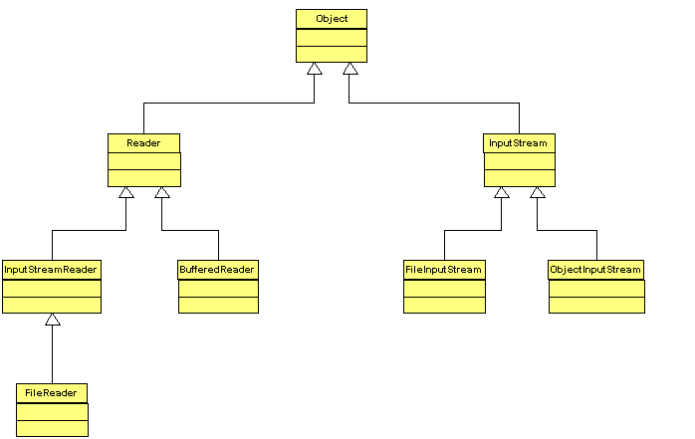
Hierarchy for Input Classes
Abstract classes
class to read raw bytes from files
Class to read characters from files

Slide 23
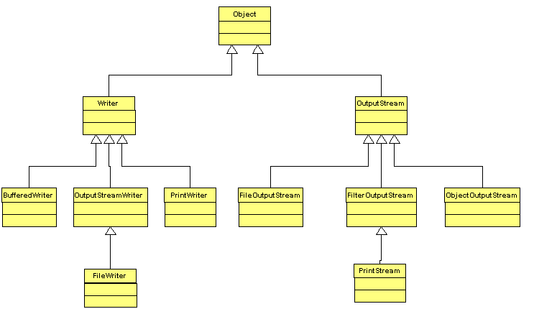
Hierarchy for Output Classes
abstract classes
class to write character files
class to write raw bytes to files

